Slide 1
ETL-project 2
Chou Khang

Slide 2
Source
https://www.kaggle.com/jadeblue/openfoodfactsclean/downloads/openfoodfactsclean.zip/1

Slide 3
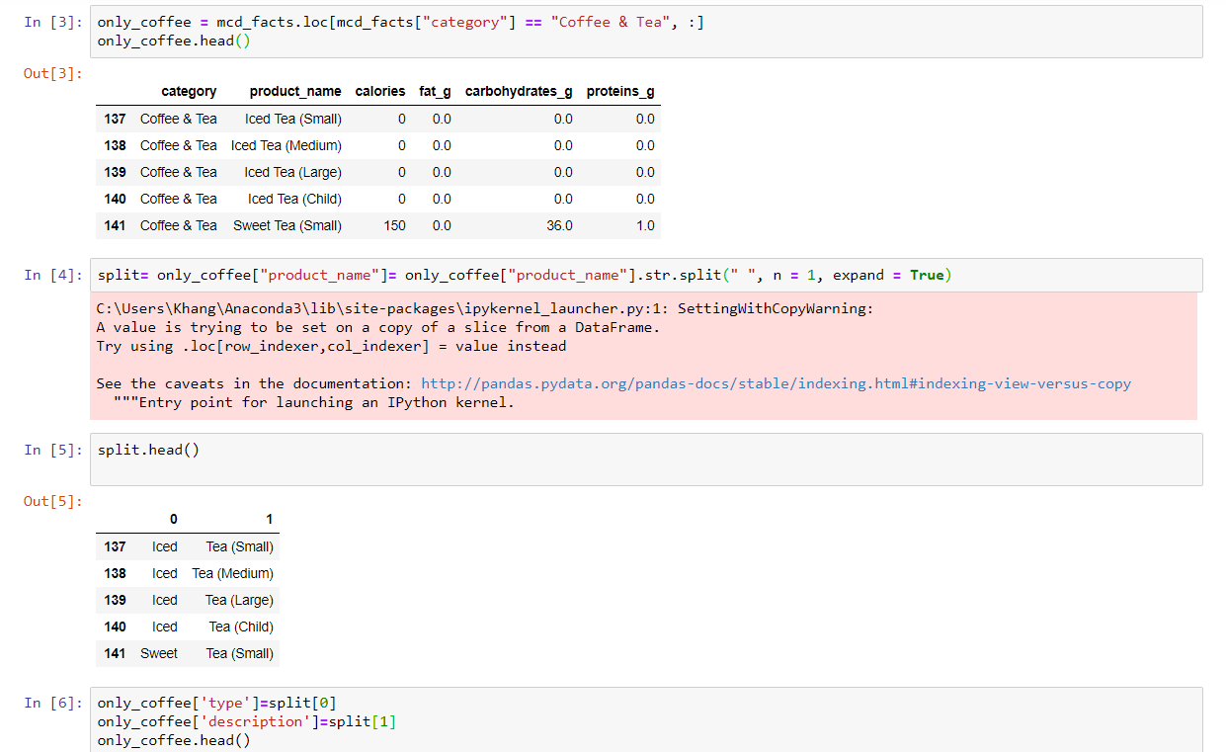
Python
Locating one coffee category
Spliting columns
Reassigning the columns back into DF
Dropping unnecessary columns
Merging the two data frame to create relational link

Slide 4
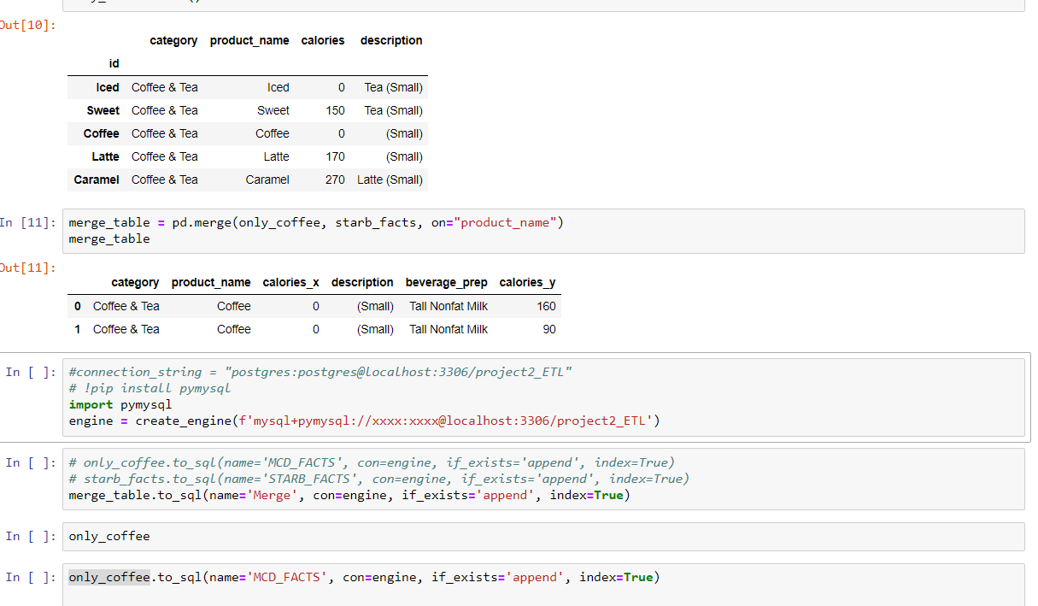
Importing
To mysql

Slide 5
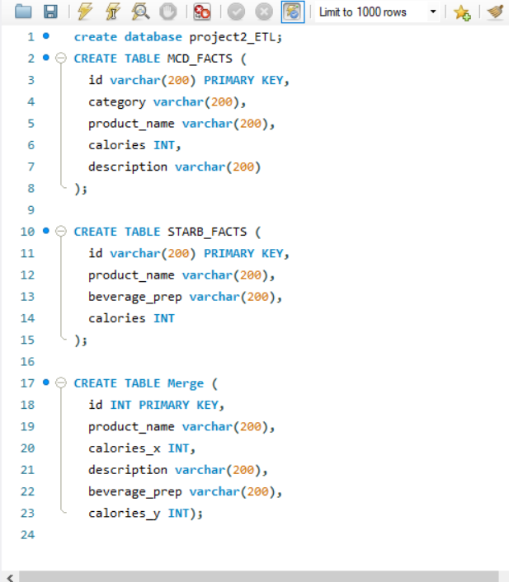
Appendin to my SQL database

Slide 6
Conclusion: I should have clean/ replace the id either in STARB or MCD dataframe to make the databases more relational

